Slide 1

Future of Windows Client
Paul Stovell
Senior Developer, Readify
Notes:
Introduction slide: this slide must be the first slide in every RDN deck. Update the following:
Title of Talk
Presenter Name
Presenter Position

Slide 2
Overview

Slide 3
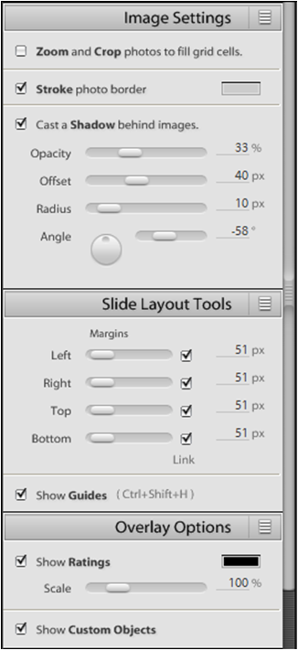

Future of Windows Forms?

Slide 4
Where is WPF right now?
Consumerware
Shrinkwrap
Consultingware
Internal LOB

Slide 5
DEMO
SeeMyRisk

Slide 6
WPF Successes
Differentiated user experiences
Styles and templates
Animation
Augmentative 3D
Designer/Developer interaction
Navigation and Exploration
Interoperation with Windows Forms

Slide 7
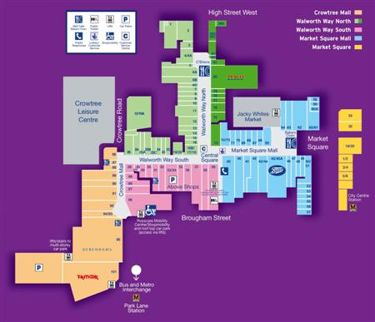

Slide 8
WPF Successes
Differentiated user experiences
Styles and templates
Animation
Augmentative 3D
Designer/Developer interaction
Navigation and Exploration
Interoperation with Windows Forms

Slide 9
DEMO
Novamind Pro

Slide 10
Where is WPF going?
Service Pack 1 Enhancements

Slide 11
Where is WPF going?
Deployment
Client Redistributable - ~30mb
Brandable ClickOnce Deployment
Deployment Bootstrapper

Slide 12
Where is WPF going?
Performance
Container Recycling
Scrolling
Virtualized TreeView
First load of CLR – 15-40% faster
Minor WPF improvements
Smoother Animations
Hardware Bitmap Effects

Slide 13
Where is WPF going?
...after SP 1?

Slide 14
Where is WPF going?
LOB Controls
Data Grid
Ribbon
Calendar, Date, Time
Masked edit, spinner
Auto completion and picklist
Breadcrumbs
Property Grid

Slide 15
Where is WPF going?
Synergy with Silverlight
Short-term conceptual compatibility
Long-term source-level compatibility
WPF as a first-class Silverlight host
Interaction between Silverlight and WPF applications

Slide 16
Where is WPF going?
Compelling UX additions
Page inheritence ala Master Pages
Transitions, layout to layout animation
Theme packs for control skins
Single Instance Application, Tray Icon/Taskbar

Slide 17
Where is WPF going?
Enterprise and Extensibility
Composite WPF Application Guidance
System.AddIn support

Slide 18
DEMO
Royal Adelaide Hospital

Slide 19
Summary
Smart client trends:
Differentiated user experiences
Inductive user interface design
Modular development
WPF focus:
LOB Controls
Performance
Improved designers and RAD
Better guidance and building blocks
Three releases in two years!

Slide 20
A Readify Developer Network session
By Paul Stovell, Senior Developer, Readify
Email Address: paul.stovell@readify.net
RDN Website: www.readify.net/rdn
Notes:
Conclusion slide – this slide must be included in every presentation deck and should be the last slide. Update the following:
Presenter Name
Presenter Position
presenter.name@readify.net

